Slide 1
Once Upon A Walmart...
by Room 2 tech girlies
Data Science And AI Group A

Slide 2
Overview
Walmart is a notable retail firm that maintains a series of hypermarkets
Here is a data merging of 45 stores with store information and monthly sales supplied on a weekly basis.
Determine impact of holidays on the sales of each store
Four holidays are Labour Day, Super Bowl, Thanksgiving and Christmas

Slide 3
Objectives
Analyze data set to achieve objectives
Clean, manipulate and understand the dataset (where required).
Visualize store sales and make the right comparisons
Build models to predict the sales of store
Evaluate the models & compare their respective scores.
Determine the impact of holidays on the stores
Give appropriate recommendation

Slide 4
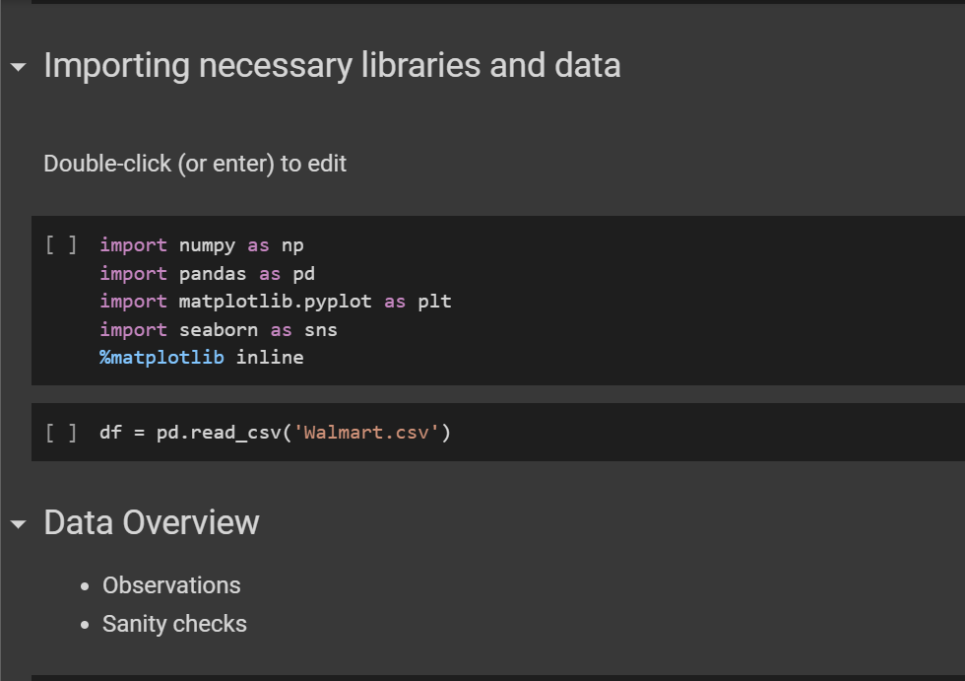
Libraries
necessary libraries for data analysis were imported
Walmart csv file read into the environment via Google drive as “df”

Slide 5
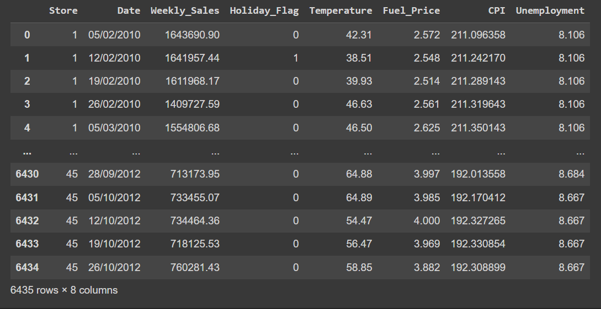
data frame

Slide 6
Data preprocessing
missing value treatment
feature engineering
outlier detection
preparation of data for modeling

Slide 7
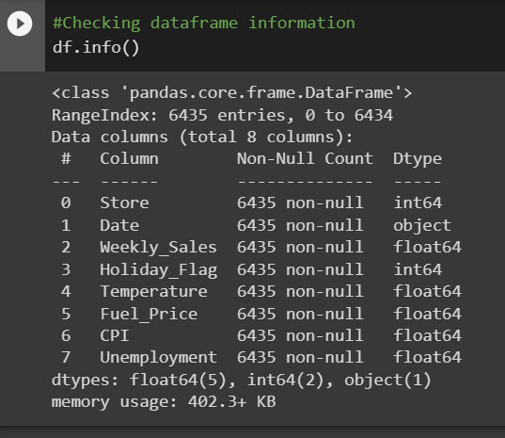
Data info & Shape
8 columns, 6434 rows
int64(2), float64(5) and object(1) data types
used df.info, df.shape to obtain this

Slide 8
Statistical data description.
Using .describe()method, obtained count, mean, max, SD and quartiles
count: giving number of rows with value in the eigh columns
mean: giving the average within each column
max: highest value of the column
min: lowest column value
first quartile:
interquartile: customer price index
third quartile:

Slide 9
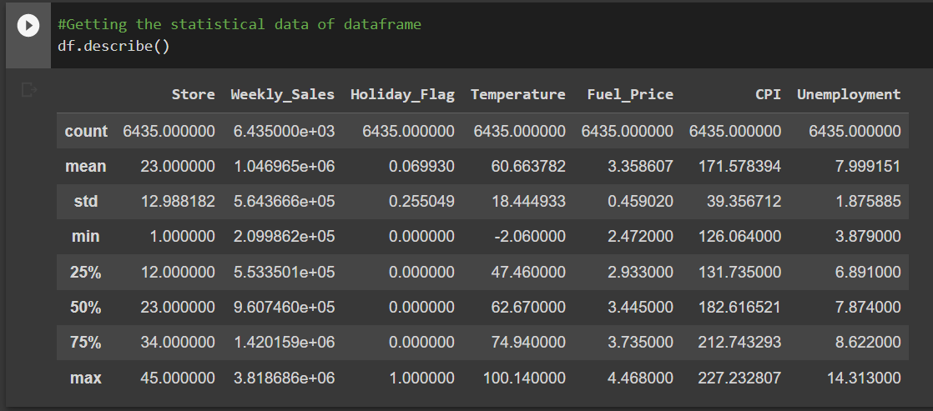
data description

Slide 10
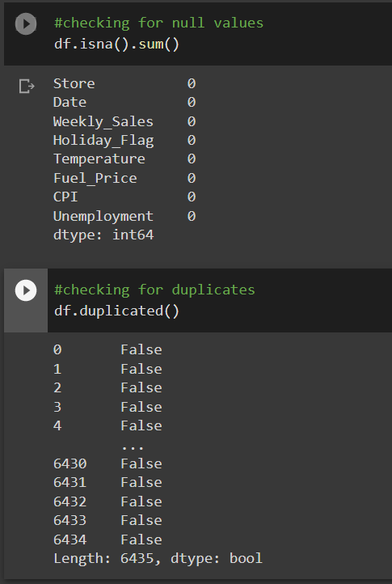
Null and duplicates
no null values or duplicated values in the data

Slide 11
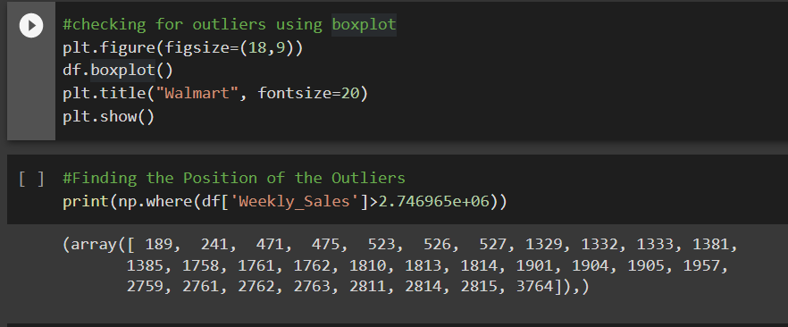
Outliers and their position on the plot
many outliers present according to box plot
position of said outliers determined.
further exploration required

Slide 12
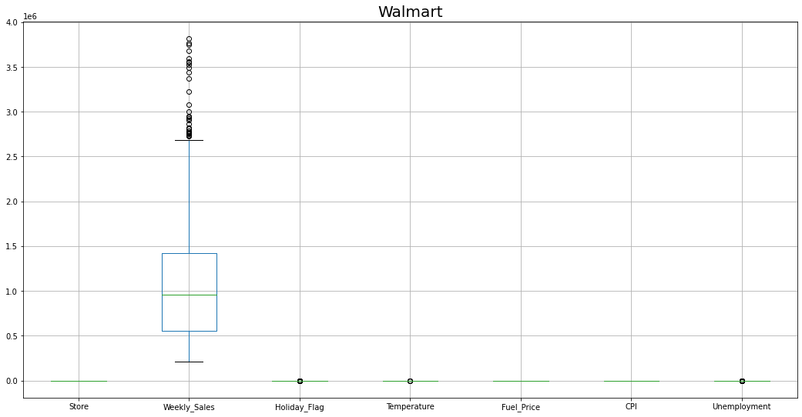

Slide 13
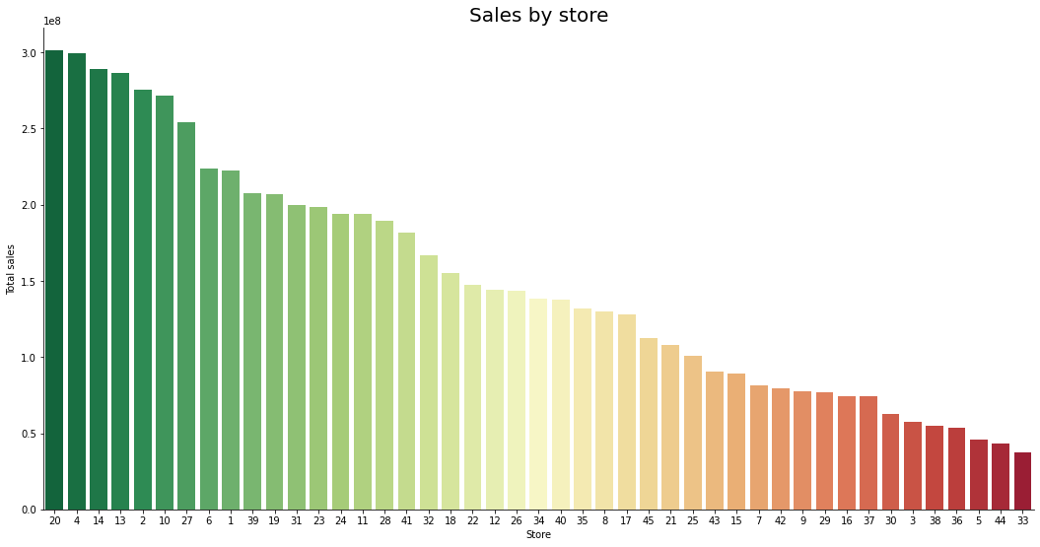
Total sales visualisation via bar chart

Slide 14
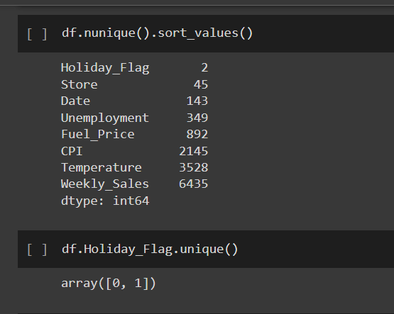
sorting unique values

Slide 15
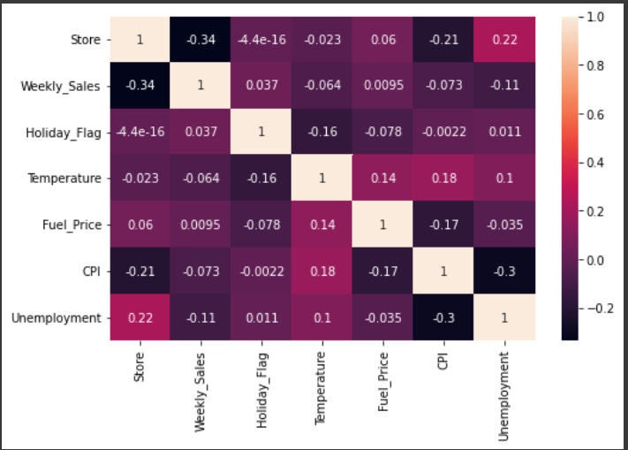
correlation between columns
interested in values closer to one, but not one
store/unemployment rate
temperature/fuel price
temperature/umemployment
temperature/cpi

Slide 16
EDA after preprocessing
Change date data type
extraction of day, month and year into separate columns
convert numerical values to categorical values in dataset

Slide 17
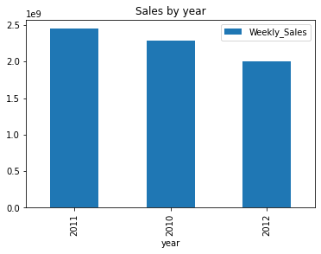
Sort and visualize annual sales by date
2011 had more sales compared to 2010 and 2012

Slide 18
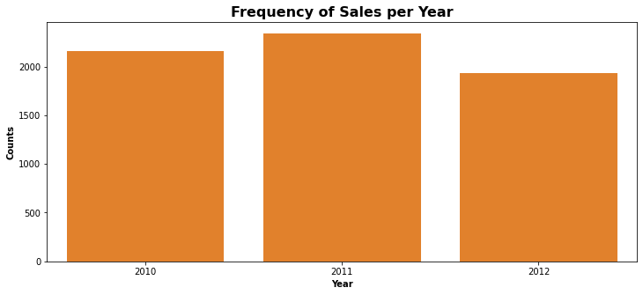
Sales by year contd

Slide 19
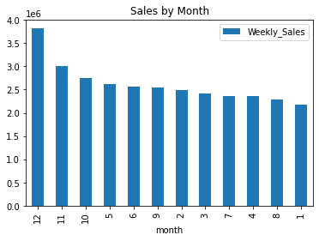
months with the highest sales and visualization
December has the highest total weekly sales compared to other months.

Slide 20
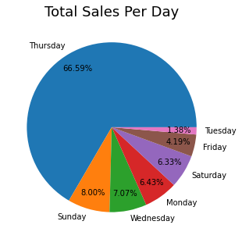
total daily sales
thursdays had the most sales combined across all three years

Slide 21
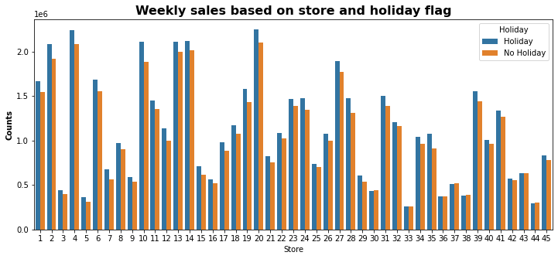
Weekly sales based on store and holiday flag
mean value of sales per store on holiday and no holiday

Slide 22
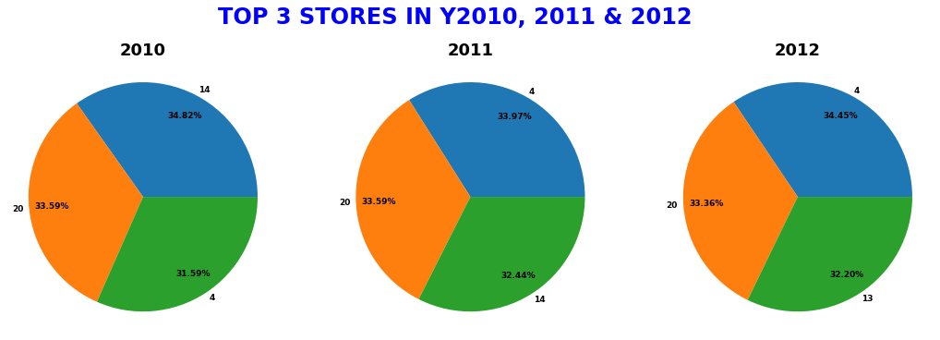
store 20 has been consistent in its sales.
store 14 sales dropped in 2011
store 4 sales rose exponentially across the years

Slide 23
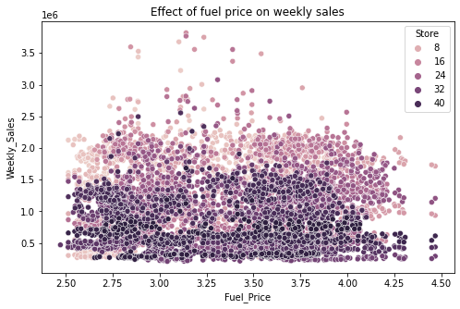
effect of fuel price on weekly sales
an increase in fuel price does not affect weekly sales

Slide 24
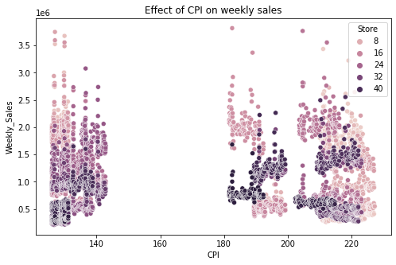
effect of cpi on weekly sales
increase in CPI leads to an increase in weekly sales across the stores

Slide 25
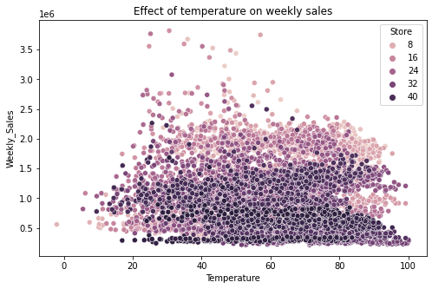
effect of daily temperature on weekly sales
more sales during the warmer weather

Slide 26
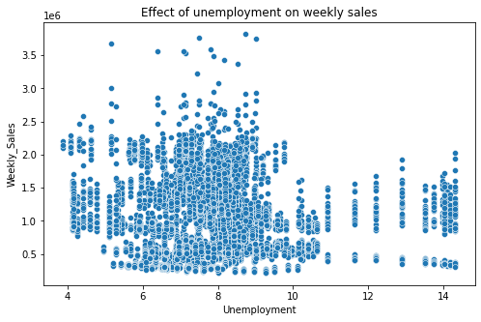
effect of unemployment on weekly sales
average unemployment rate leading to a constant in the weekly sales across the stores

Slide 27
data scaling and splitting
dropping redundant date column
Label Encoding

Slide 28
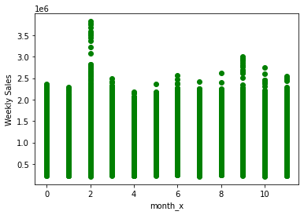
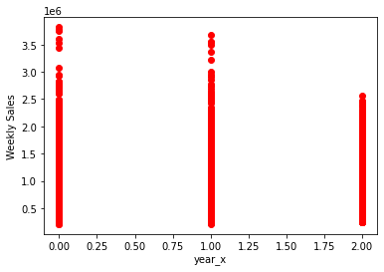
Label encoder: training data

Slide 29
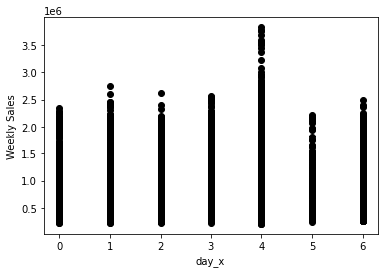

Slide 30
To Note!
Generally, algorithms that rely on rules do not require normalization/scaling.
Since we are working with algorithms that are rule-based e.g gradient boosting, decision tree, scaling/normalisation is not needed.
Feature scaling is especially used for machine learning algorithms that calculate distances between data.

Slide 31
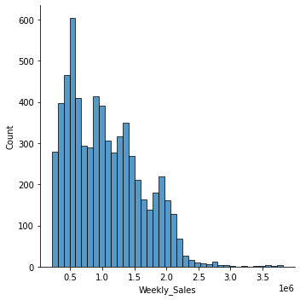
Univariate analysis

Slide 32
Modeling
Linear regression
Gradient boosting
Decision tree

Slide 33
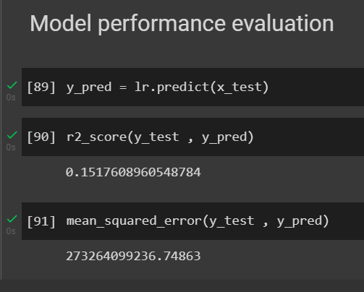
Linear regression
training data was 80% of the df, 20% of df was test data
score too low, this model not recommended

Slide 34
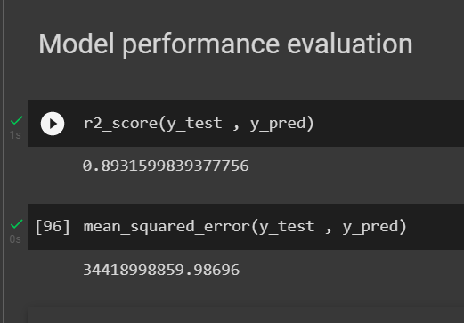
Decision Tree
80% training data, 20% test data.
model score at 0.89. model scores good, but could be better

Slide 35
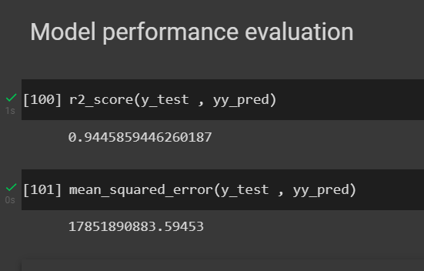
Gradient boosting
GRB has better overall score of the three models, hence recommended.

Slide 36
Model performance and eval
Linear regression score = 0.15
Decision Tree score = 0.89
Gradient Boosting score= 0.94

Slide 37
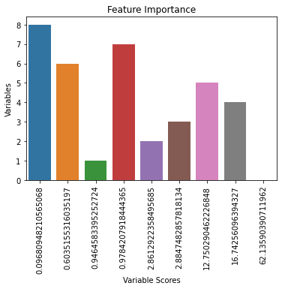
Final model summary and feature importance
Store
Holiday_Flag
Temperature
Fuel_Price
CPI
Unemployment

Slide 38
Actionable insights and recommendations
there isn’t enough data on the stores’ locations to suggest maximising of weeks when sales were low
some stores had consistent sales even during holiday season
stores that have low weekly sales would run out of business pretty fast.
management of these stores could seek ways on how to boost their sales

Slide 39
ありがとうございます
Questions?

